Slide 1
Thinking Critically
Or how NOT to be fooled!

Slide 2
You’ll need to know:
Inference
Looking at available evidence and using logic to draw a conclusion

Slide 3
But when can inference
go wrong?

Slide 4
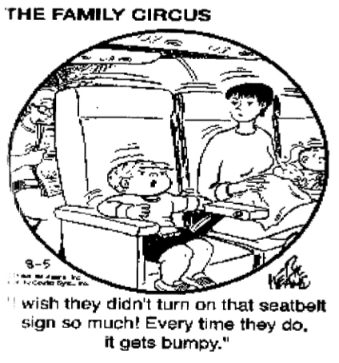
Correlation
is not causation
Inferring events/data that happen at the same time or rate, (correlation) means one caused the other (causation.)

Slide 5
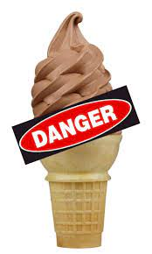
Conclusion
Fact!
Ice cream sales and drowning deaths rise and fall at a similar rate.
Ice cream causes drowning!

Slide 6
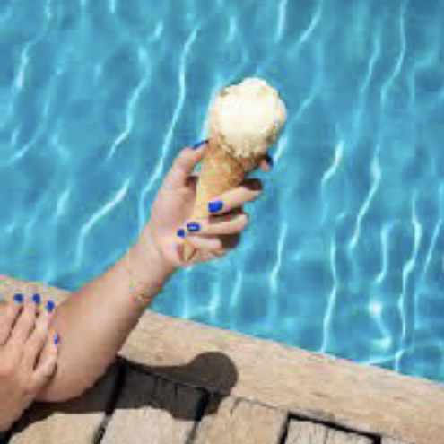
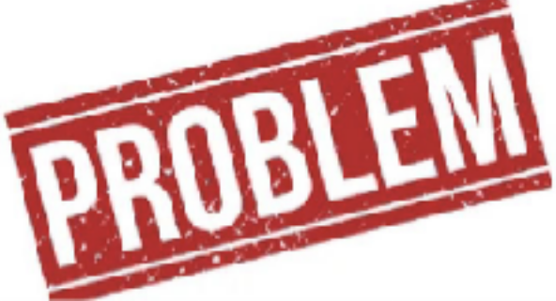
Nope, it an example
Ice cream sales increase in the warm summer months.
that correlation is not causation!
More people go to the pool or the beach in the summer months.
Causation! The cause of the correlation is warmer weather.

Slide 7
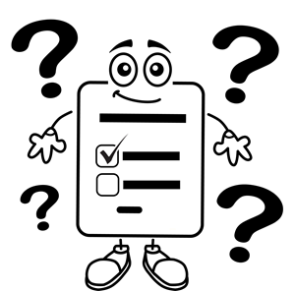
Experimenter bias
Inferring information is valid when the questions used to gather it were bias or leading

Slide 8
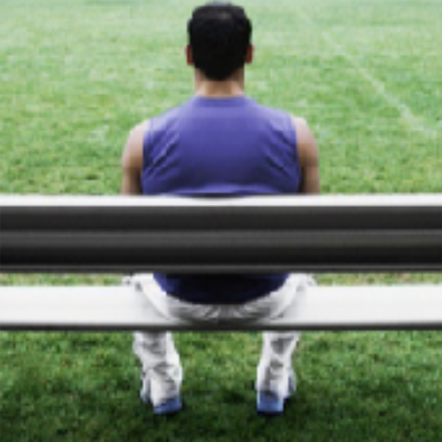
Would you rather increase mandated testing of students or would you rather students fall further behind?
How do the following questions push an individual to answer in a way the experimenter wants?
Should aggressive coaches be allowed to give more playing time to their favorite player and leave other distraught students sitting on the bench?

Slide 9
Which words or phrases show bias?

Slide 10
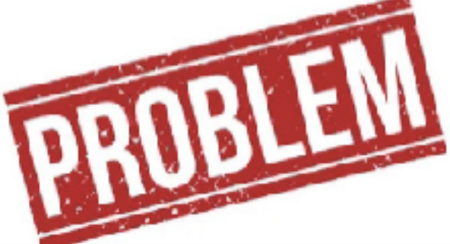
Problems:
Would you rather increase mandated testing of students or would you rather students fall further behind?
This is a false, either/or choice.
The choices are vague.
What is meant by “increase” and “further behind?”

Slide 11
Problems:
Should aggressive coaches be allowed to give more playing time to their favorite player and leave other distraught students sitting on the bench?
“Aggressive”,“favorite”, & “distraught” are loaded words.
No specific information or details is given.
Are the students in kindergarten or high school?
Did the other student attend practices and work hard? Is it a competitive league or a school team?

Slide 12
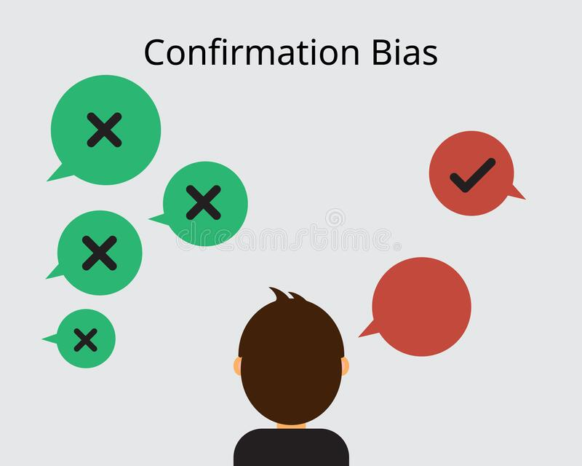
Confirmation bias
Believing or accepting only the information that supports the desired conclusion

Slide 13
Myra and Lily accused each other of cheating on the exam
Lily is your friend, and you believe she would never cheat.
Myra has to be the guilty one!

Slide 14
Myra struggled on past tests.
What evidence is available?
Myra scored better on this test.
Lily has a small piece of paper with notes but explained it was for studying on the bus.
Myra was seen studying before school.
Lily will be grounded and miss Saturday’s party if she does poorly on the test.

Slide 15
You are using confirmation bias if you
Only accept the information that
supports Lily’s innocence
points to Myra’s guilt
Ignore the information that
supports Myra’s innocence
points to Lily’s guilt

Slide 16
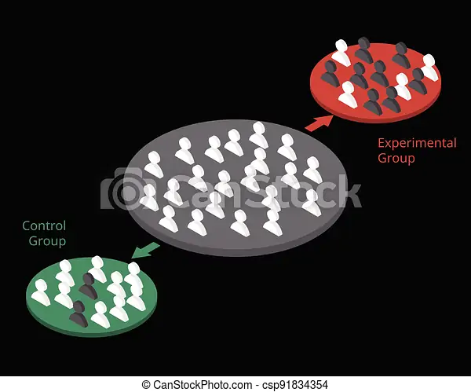
Lack of a Control Group
Inferring any change shows the actions taken worked even if there was no control group.
Control group: a group that does not experience the change.This demonstrates the improvement was due to the action rather than other factors

Slide 17
Mr. Gonzalez tries something new
History teacher, Mr. Gonzalez, read about the brain benefits of playing music at the start of class. During the unit,Westward Expansion, Mr. Gonzalez played classical music each hour.
The students scored 5% higher on the West test.

Slide 18
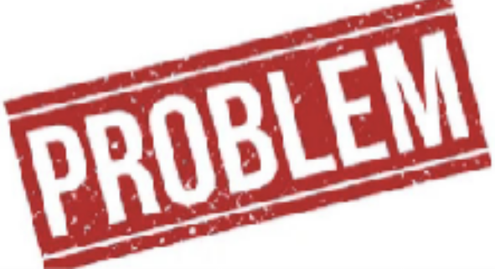
Mr. Gonzalez did not have a Control Group
Other factors could have contributed to the better grades.
The unit or test may have been easier.
Student may have studied more.
Mr. Gonzalez may have unconsciously taught better because he thought grades would improve.
Using music in only some of his classes and comparing the scores would have provided a control group and more valid results..

Slide 19
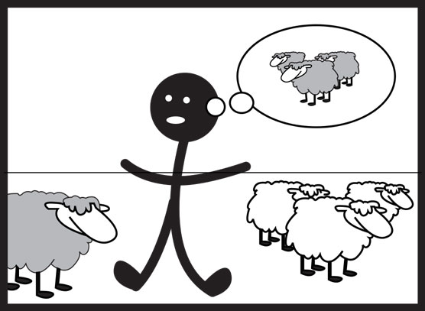
Overgeneralization
Inferring conclusions made about a small group or sample will apply to all.

Slide 20
Principal Woolwine orders lunch for 500 students
Principal Woolwine decides the menu in the lunchroom needs updating. He sees three boys in the hall and asks their opinion.The students suggest breakfast burritos.
The next week, breakfast burritos are the main item on the menu.

Slide 21
Using three students in the hall is not a strong sampling.
Mr. Woolwine overgeneralized
The sampling is too small.
The three were probably friends and have similar tastes.
A survey of all students or a survey that takes a sample reflecting the makeup of the student body is necessary.

Slide 22
So can you spot the problem and not be fooled?
Random chance
Correlation is not causation Experimenter bias Confirmation bias
Lack of a control group Overgeneralization

