Slide 1
Statistics CER
Using critical thinking to evaluate claims, evidence and reasoning in statistics

Slide 2
Objective
Students will use measures of central tendency to evaluate CERs for validity and reliability.

Slide 3
Warm up
Class survey
Discussion
10 mins
10 mins
30 mins
20 mins
15 mins
Mini-Lesson
CER

Slide 4
Let’s Review:
How do we calculate measures of central tendency and what can we use them for?
Complete the worksheet to remind yourself of the process!

Slide 5
Mean - Median - Mode - Range
How do we calculate mean, median, mode and range?
Mean
Range
Add all of the numbers and divide by N (# of items)
Find the difference from the lowest and highest point in the data.
Median
Mode
Find the middle point- Even number? Find average of middle points.
Find the number that occurs the most. More than one? It’s multi- modal.

Slide 6
Additional Review
Let’s check out the MathAntics take on mean, median and mode!

Slide 7
Class Survey
Step 1
Create a statistical question.
Step 2
Post questions on wall.
Step 3
Use data to compute mean, median, mode and range.

Slide 8
Statistical Questions
Have numerical answers
The answers can vary.
Examples
How old am I?
-Not statistical, only one answer.
How old are my classmates?
-Statistical, many possible answers

Slide 9
Data Collection
Once all papers are on the wall, we will line up and take turns putting our responses on each other’s papers.
Be sure to give a clear numerical answer to the question.

Slide 10
Calculating Measures of Central Tendency
We will use measures of central tendency to understand the middle of our data set.
First: order your data points from the lowest point to the highest point.

Slide 11
Calculating Measures of Central Tendency
Mode
The number that occurs the most. If there is more than one, the data set is multi-model.
Range
The difference between the highest and lowest data points.*
Sum of All Data Points
Mean =
Number of Data Points
Median
Find the middle #. If there are two, take the average of those #s.
* Not a measure of central tendency, but informative to have.

Slide 12
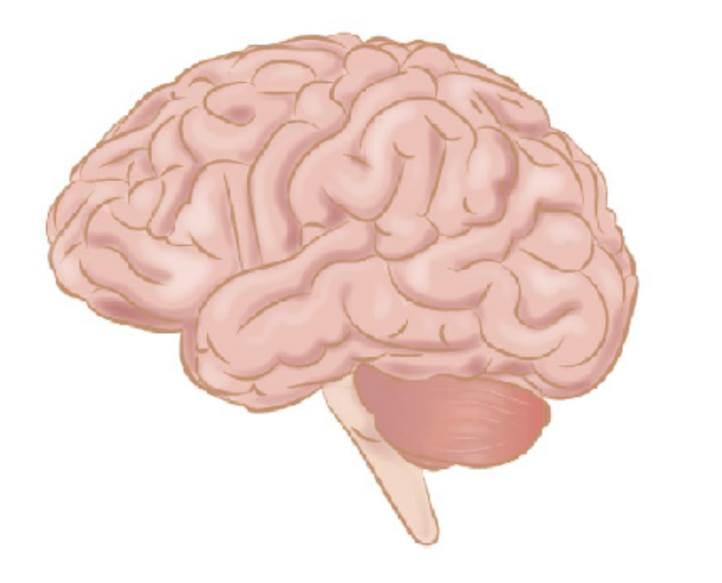
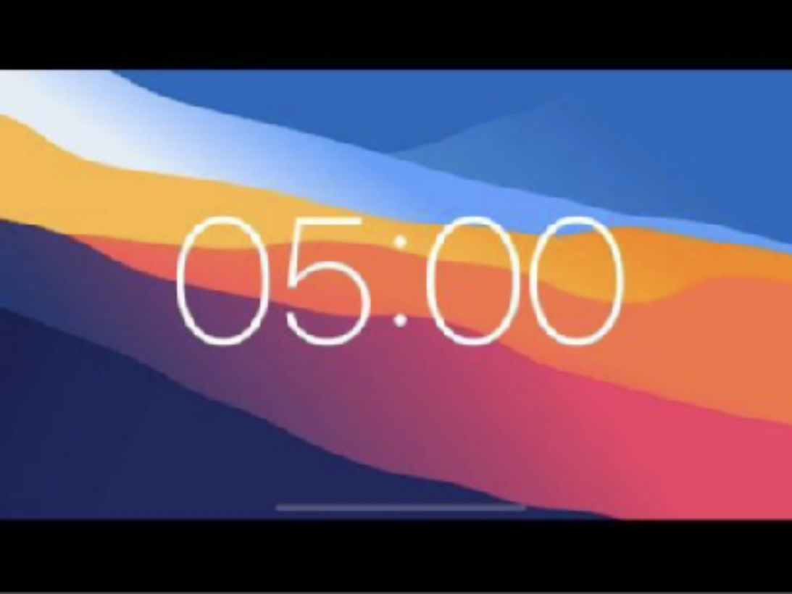
Brain Break

Slide 13
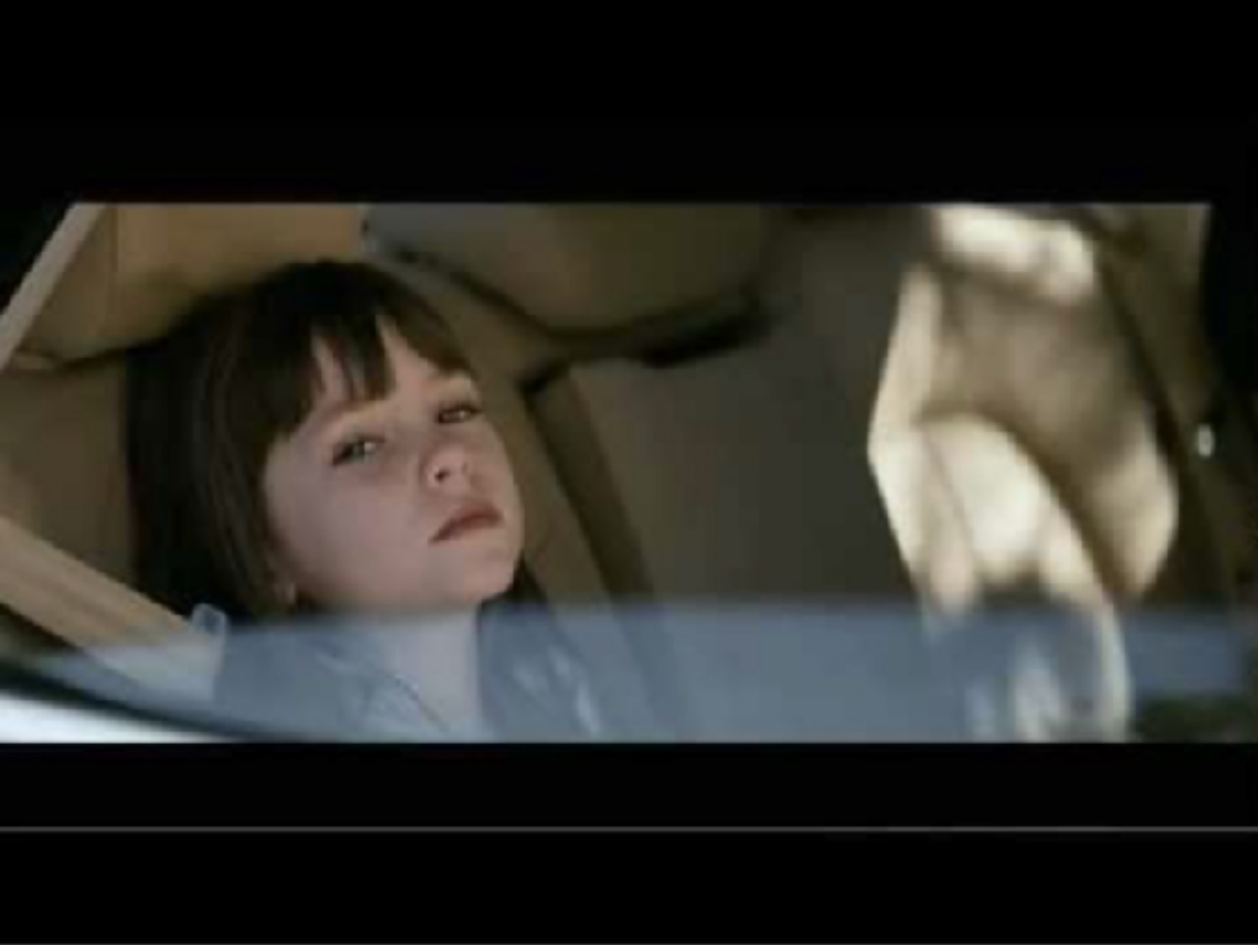
Writing a CER
What is the
claim? evidence? reasoning?

Slide 14
CER Process
Claim
My dad is a space alien.
Evidence
He speaks a weird language, drinks green stuff, appearance (bike gear), and has a spaceship.
Reasoning
The behaviors of my dad are the same as those of a space alien. Therefore my dad is a space alien.

Slide 15
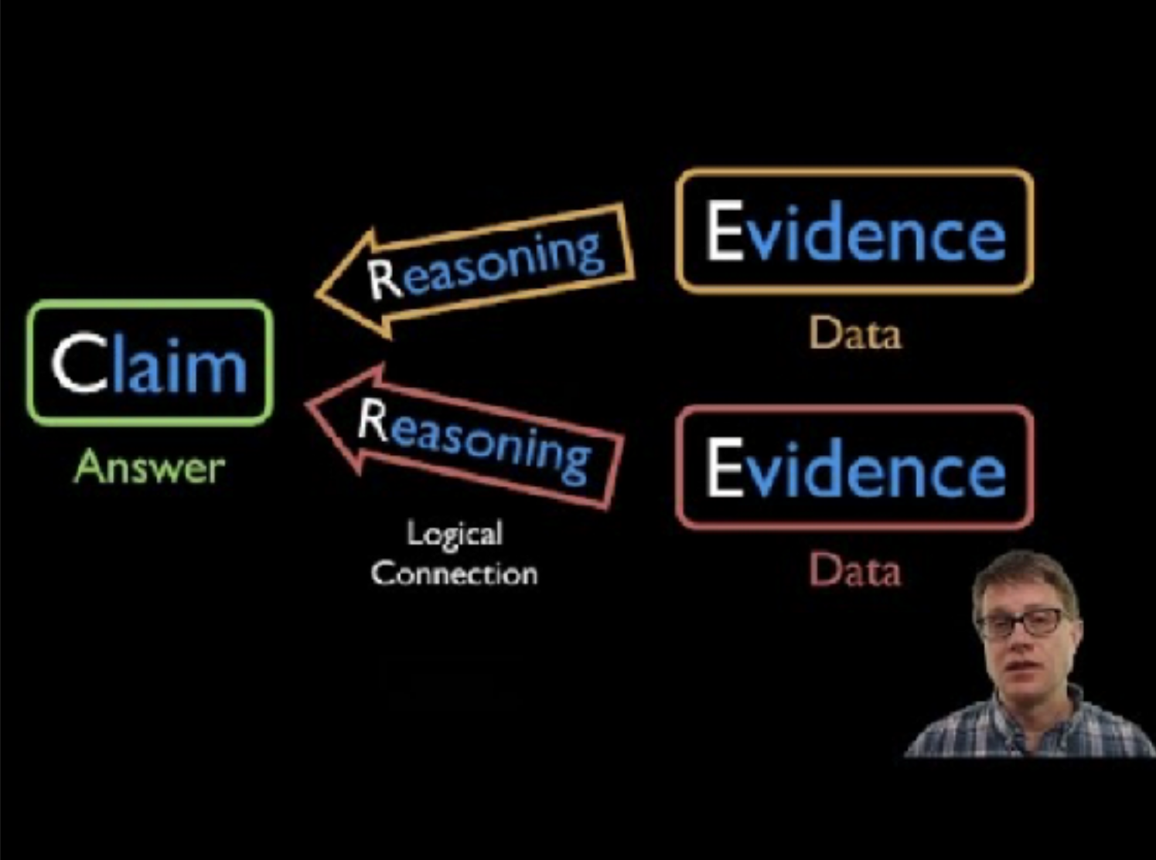
CER Process: Additional Review
List examples of claims, evidence and reasoning based on this video.

Slide 16
Claim
Looking at your mean, median, mode and range, how can you summarize your data?
Discuss your strongest claim with a partner.

Slide 17
Claim
Using feedback from your partner, write down your claim as a complete sentence.

Slide 18
Evidence
Using your data (mean, median, mode, range), write a sentence that provides evidence for your claim.

Slide 19
Reasoning
Link your claim and your evidence together with reasoning.
Why does this evidence back your claim?

Slide 20
Fallacies of Logic
Type of fallacy
Definition
Example
Overgeneralization | Making a claim based on not enough evidence. | Middle school students prefer sweet food to salty food. Sampling one class of middle schoolers is not enough data to generalize to ALL middle schoolers.
Confirmation Bias | Making a claim that is based on focusing on evidence that fits with our existing beliefs. | Our class prefers chocolate to vanilla. Just because you and your friend group prefer something doesn’t mean that this is representative of the entire group.
Ambiguity Effect | We avoid options that are unclear or missing information. | Our class will prefer brownies to dark chocolate tarts. Just because brownies are a more familiar dessert to you doesn’t mean this will be the preference of your group.

Slide 21
Class Discussion
Do you see any examples of these fallacies of logic in action?
Which fallacy do you see?
How can we correct it?

Slide 22
Closing
How did we use measures of central tendency to evaluate CERs for validity and reliability?
How can we use these strategies in the future…inside and outside of the classroom?
21

