Slide 1
5th Grade Math

Slide 2
Objectives
The students will be able to identify the type of bias or other fallacy in a math example by using critical thinking skills.
The students will be able to explain why this example is biased or contains a fallacy.
5th Grade Math
1

Slide 3
The 5 Types of Fallacies
Correlation
is not causation
Bias
Random chance
Lack of control group
Experimenter bias
Confirmation bias

Slide 4
Type of Fallacy
Definition
Example
Experimenter bias
A pie that is cut into 8ths is shown with 3 pieces cut out of it.
A question is given. What is 1 minus 3/8ths?
Results from an experiment may be incorrect because information may have been given to participants which may have influenced their decisions

Slide 5
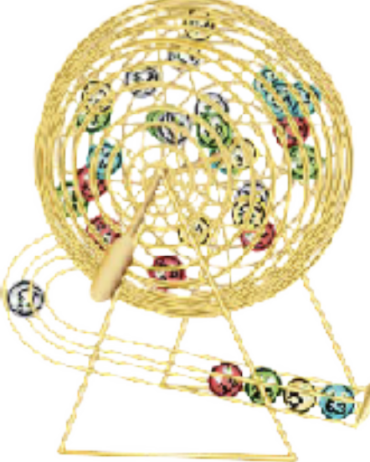
Type of Fallacy
Definition
Example
Confirmation bias
Accepting something as true because you want it to support your ideas
Your number for a raffle is number 16. Out of 24 numbers, you know yours will be picked even though the probability shows that you have a 1/24 chance to win.

Slide 6
Definition
Example
An experiment or researched study does not include a group being experimented on in which to compare.
Three different-sized containers are used. Each container is filled with ice and then water to the brim without spilling.The student wants to find out if the water spills over the side of the container when the ice melts.
The volume for each shaped container is shown.
Type of Fallacy
Lack of control group
*cube (3x3x3) = 27 inches 3
*prism (base = 4 height = 2 inches) = 8 inches
*rectangular solid (l x w x h) = 6 x 2 x 4 = 48 inches

Slide 7
Definition
Example
Type of Fallacy
Random Chance
A way in which luck or chance occurred for an event to happen with no strategy being involved.
It rained on the fourth day, eighth day, 16th day and 32nd day. The other days did not have any rain.
What is the pattern?

Slide 8
Type of Fallacy
Definition
Example
Correlation is not causation
Two or more things are related, but one does not cause the other.
Two lines are not perpendicular, so they must be parallel.

Slide 9
Create a word problem
Choose a fallacy type.Then write a math word problem using that fallacy type.The fallacy must be included in your word problem.

Slide 10
Review
The 5 Types of Fallacies
Correlation
is not causation
Bias
Random chance
Lack of control group
Experimenter bias
Confirmation bias

