Slide 1
4th Grade Math

Slide 2
Objectives
The students will be able to identify the type of bias or other fallacy in a math example by using critical thinking skills.
The students will be able to explain why this example is biased or contains a fallacy.

Slide 3
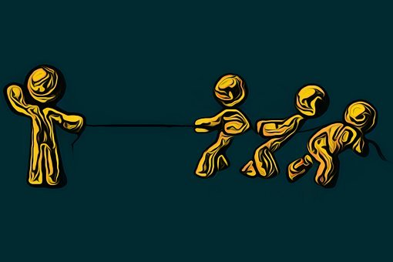
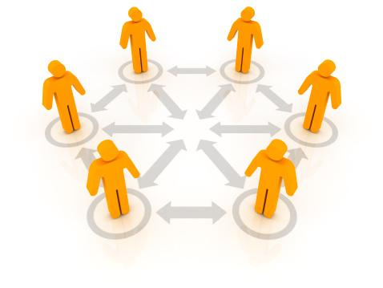
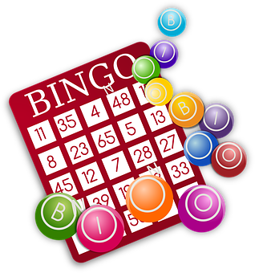
3 main fallacies
Correlation
is not causation
Bias
Random chance

Slide 4
Find Bias
Look in newspaper or magazine articles for bias. Find an example of bias with numbers. Be ready to explain how this bias is a fallacy.

Slide 5
Bias
An opinion or thought not based on evidence or experience

Slide 6
Math example
There is a sale at a store.The price tag is hidden.Without looking at the price tag, a woman makes a comment that she could afford the small piece of jewelry because she has
$100,000.
Bias
An opinion or thought not based on evidence or experience
Look at the price tag of the small piece of jewelry. Round the price tag to the nearest hundred thousandths to determine if the woman could afford it.
Could include a group
Could include more information or withhold information to persuade the reader
$999,010.00

Slide 7
Correlation is not causation
Two or more things are related, but one does not cause the other

Slide 8
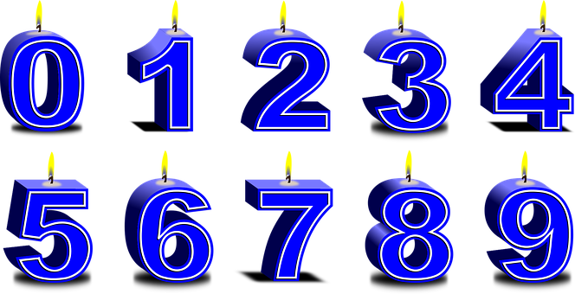
Find Correlations!
Find two numbers or situations that have something in common with each other. Explain how these numbers are related.

Slide 9
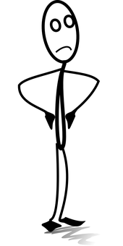
Correlation is not causation
Math example
Two or more things are related, but one does not cause the other.
“The fraction, 5/8, must be a bigger fraction than the other because both numbers in this fraction are larger than the other fraction, ¾.”

Slide 10
Random Chance
A way in which luck or chance occurred for an event to happen with no strategy being involved

Slide 11
Bingo Chances
Explain how playing bingo is a game of chance.What probability do you have for winning?
4th Grade Math

Slide 12
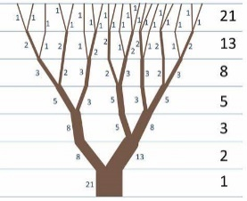
Math example
Patterns and sequences happen in nature. Look at the picture of the tree and number of branches.What would be the next number in the patterns?
Random Chance
A way in which luck or chance occurred for an event to happen with no strategy being involved
4th Grade Math

Slide 13
Review
3 main fallacies
Correlation
is not causation
Bias
Random chance
4th Grade Math

